Slide 1
Technical Documentation on Lab 2 Reproduce (Shared Wallet)
Rizqy Eka Putra Rizaldy
School of Electrical Engineering
Department of Computer Engineering
1103184149

Slide 2
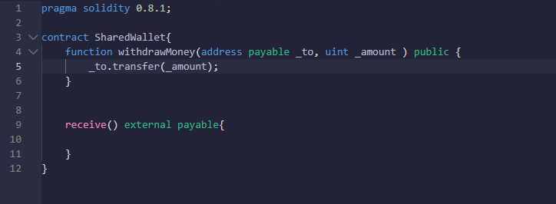
Basic Smart Contract for Shared Wallet
First we will define the basic smart contract for shared wallet,
with capabilities to withdraw and receive Ether

Slide 3
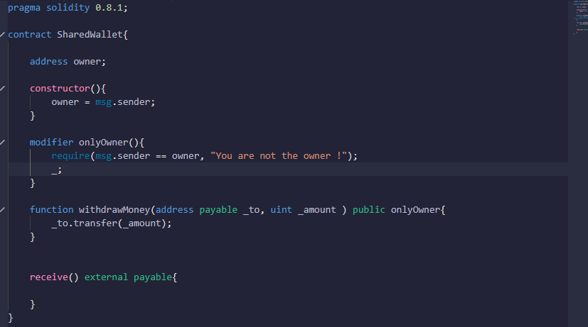
Add Only Owner Function
Add “onlyOwner” modifier to adjust permission so that only owner is allowed to withdraw

Slide 4
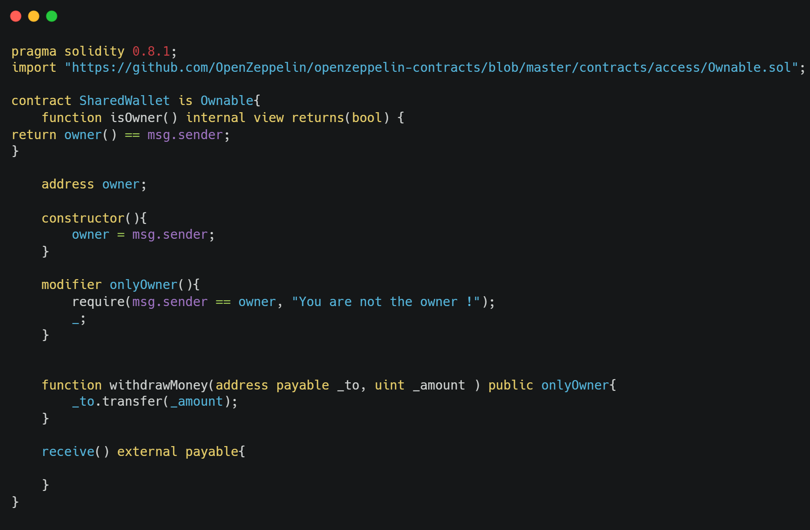
Add OpenZeppelin Ownable Functionality
Owner-logic directly in one smart contract isn't very easy to audit. Therefore, it was needed to break it down into smaller parts and re-use existing audited smart contracts from OpenZeppelin for that.

Slide 5
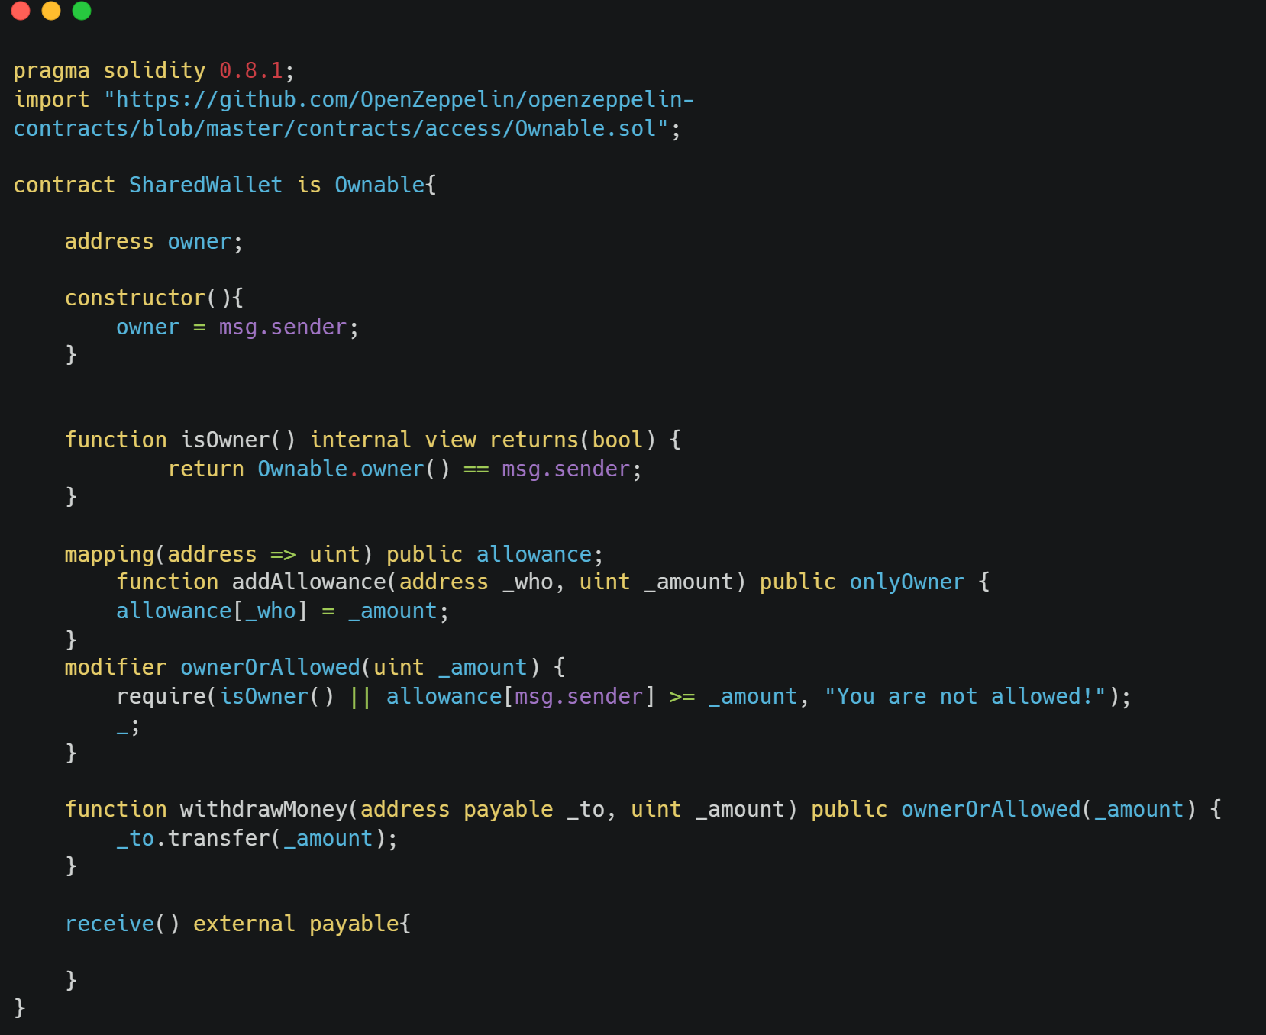


Add Mapping to Store Address
In this step we add mapping so we can store address in form of uint amounts. This will be like
an array that stores [0x123546...] an address, to a specific number.

Slide 6
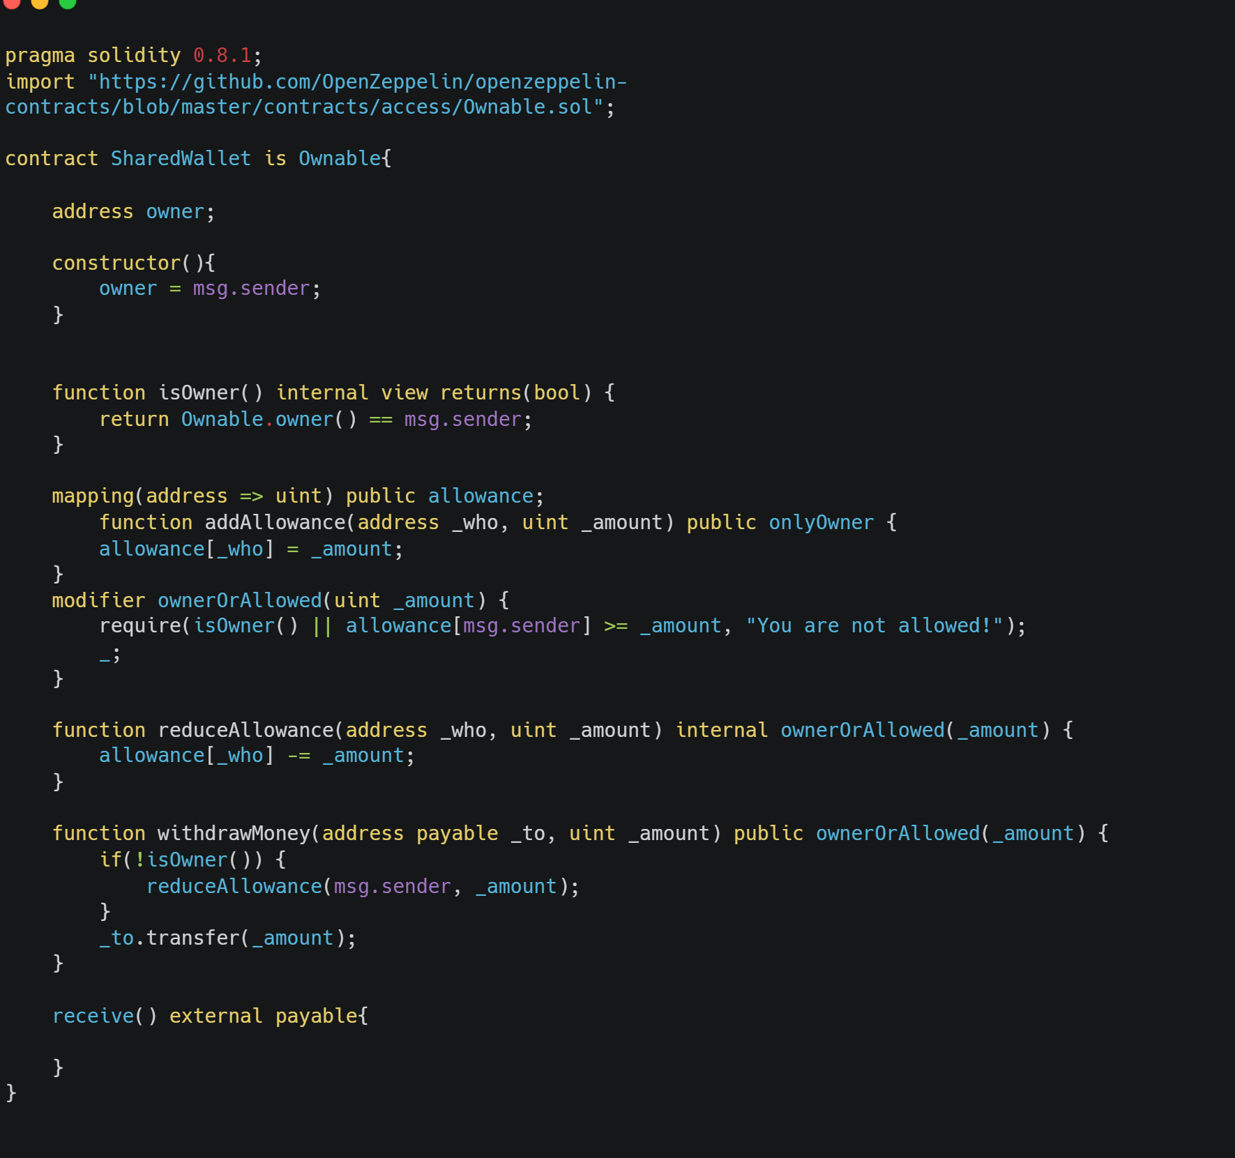
Improve/Fix Allowance to avoid Double-Spending
In this step we add mapping so we can store address in form of uint amounts. This will be like
an array that stores [0x123546...] an address, to a specific number.

Slide 7
Split Code Into 2 Files
After all the step above are completed, we can structure the smart contract differently. To make it easier to read, we can break the functionality down into two distinct smart contracts.
Note : since Allowance is Ownable, and the SharedWallet is Allowance, therefore by commutative property, SharedWallet is also Ownable.

Slide 8
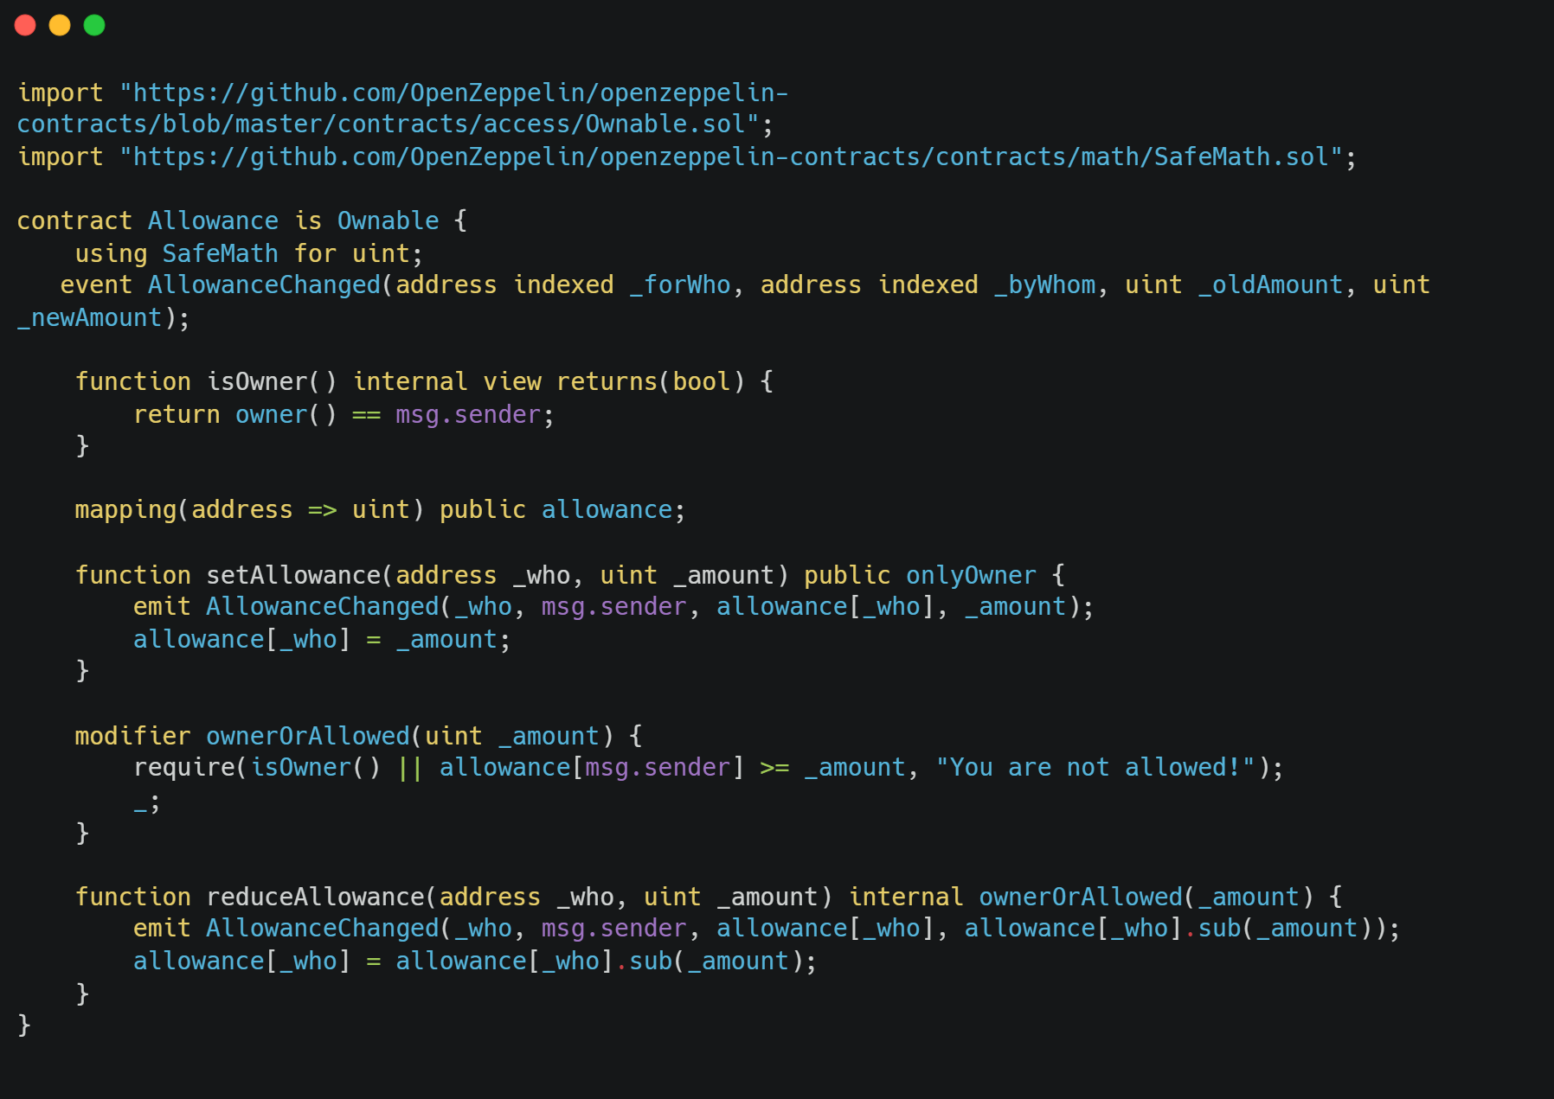
Split Code and Add Event Emit : Allowance Contract

Slide 9
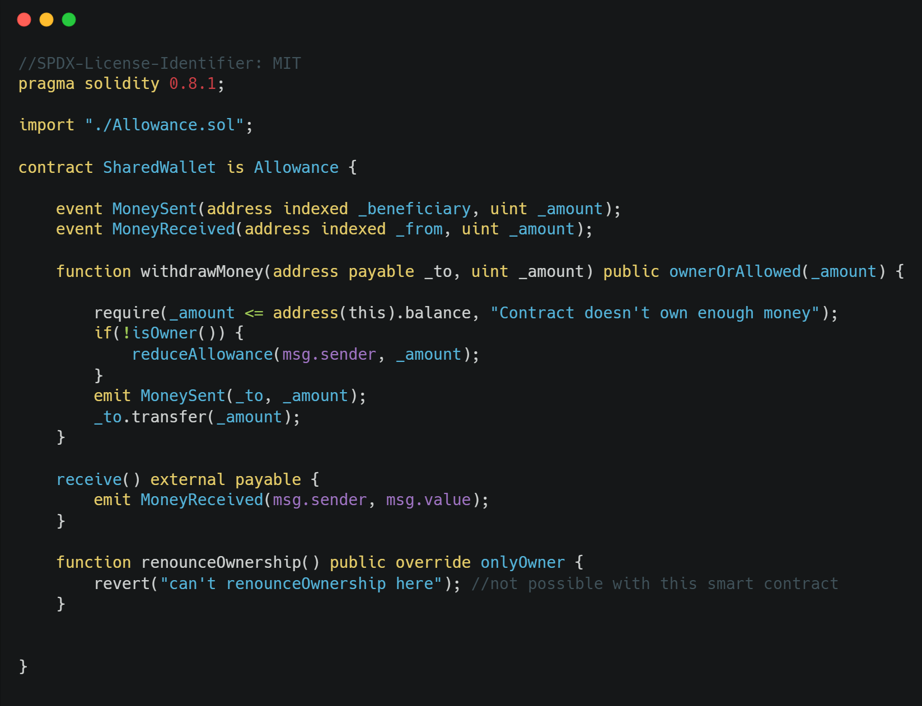
Split Code and Add Event Emit : Shared Wallet Contract
Note that we also add renounce Ownership
Function to prevent removal by reverting the
transaction

Slide 10
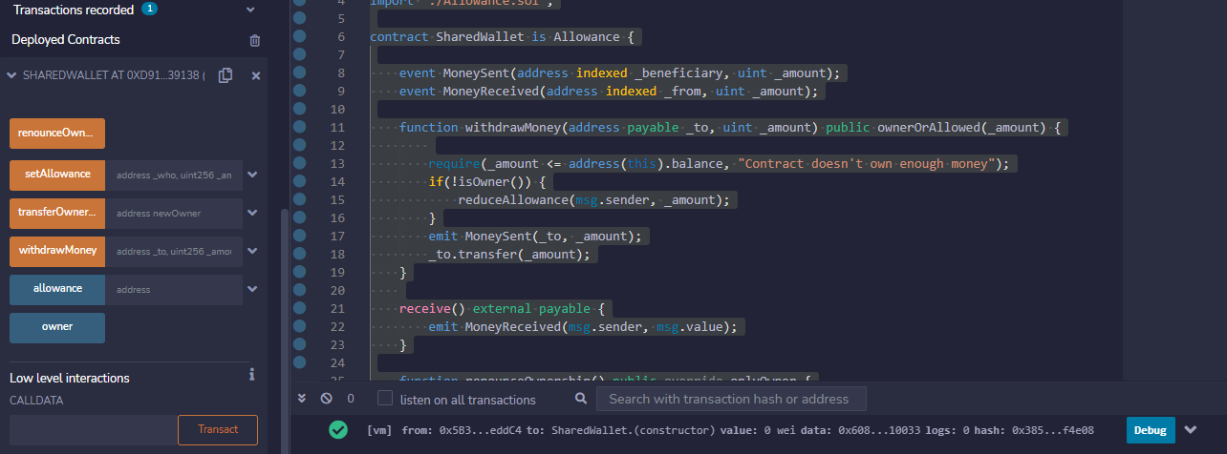
Smart Contract Deployed

Slide 11
Lab Done
And that is the example of applying blockchain on a simple supply-chain application!

